Slide 1
Optical communications and data networks (EENGM2001)
Siddarth K Joshi

Slide 2
Receivers
Transmitter
Medium
Receiver
Laser/LED
Modulator
Optical Fibre
Free space
Photodiodes
Homo/heterodyne detectors
Optical communications use light.
Computers and other things connected to the network use electricity.
Receiver: transducer to convert optical to electronic.
(must also demodulate light to recover data)

Slide 3
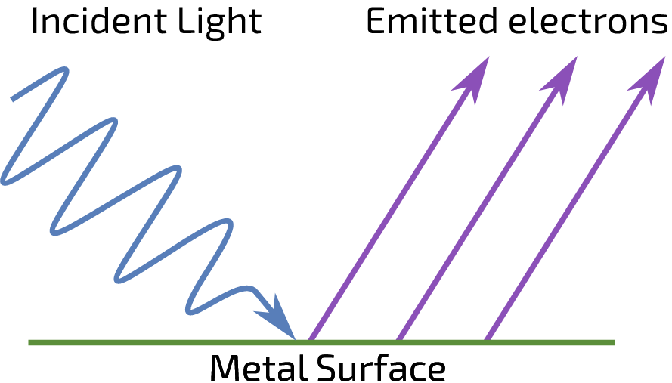
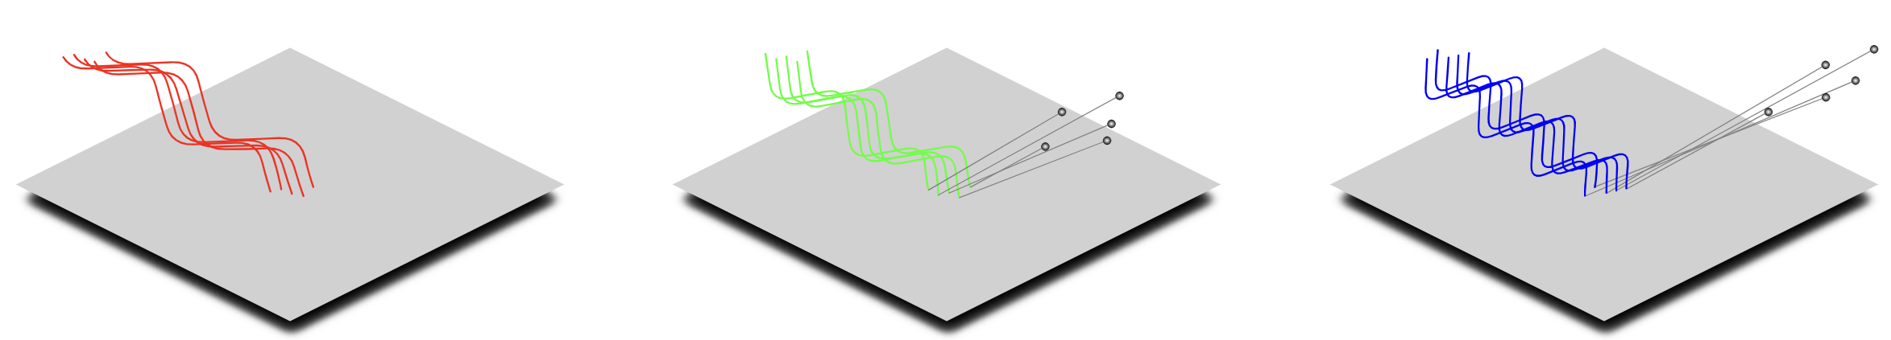
Photoelectric effect
Is quantised!

Slide 4
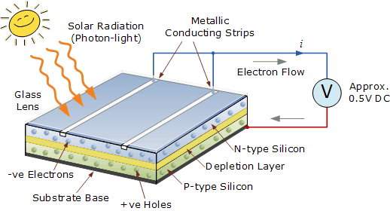
Photoelectric effect
This is the external photoelectric effect
Electrons emitted

Slide 5
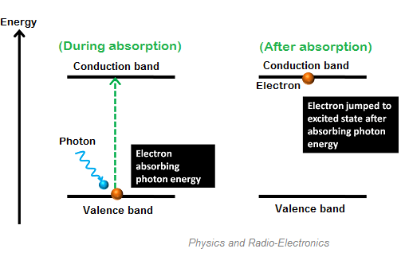
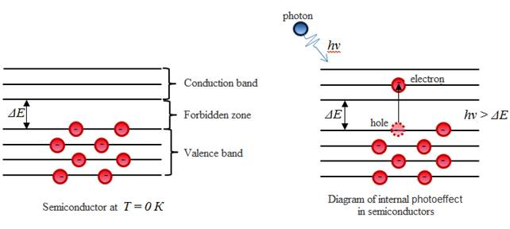
Photoelectric effect
Internal photoelectric effect
Photo current seen in reversed biased junction
1 absorbed photon will produce 1 e-h pair

Slide 6
Photoelectric effect
E (electron energy)
-
Conduction band
E_{C}
-
-
-
K (electron momentum)
E_{g}=E_{C}-E_{V}
E_{V}
+
+
+
Valence band
free electrons and hole are generated into the C-band and V-band respectively due to the absorption of a photon
They are extracted to form an electric current
In order for this to happen, the photon energy must be >= Eg
+
-E (hole energy)

Slide 7
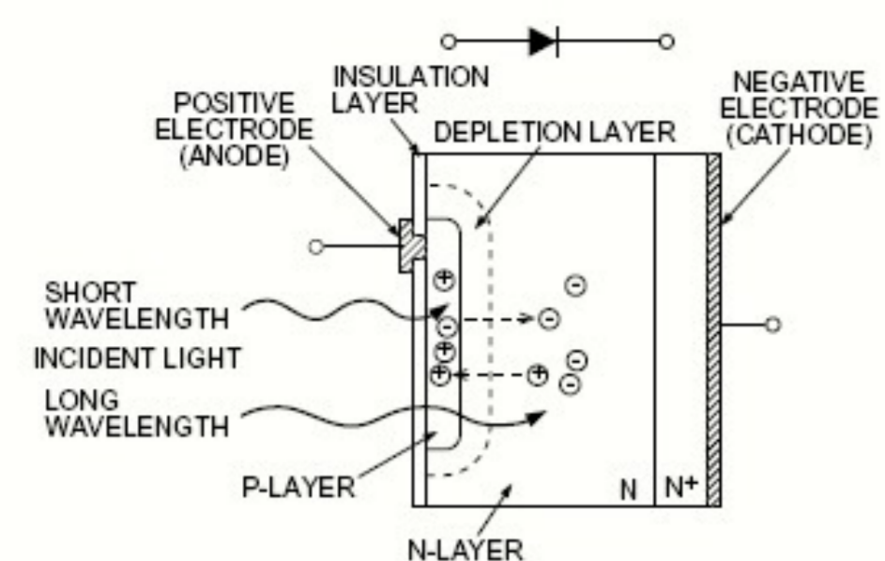
PIN diodes
Simplest type of photodiode
Intrinsic piece of semiconductor is sandwiched between two heavily and oppositely doped regions.
The two charge sheets (on the n and p) sides produce a field to separate charges produced in the depleted region.
The separated charges are collected by either terminal and form a current (provided that they did not recombine)

Slide 8
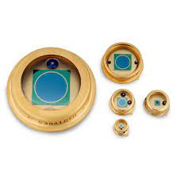
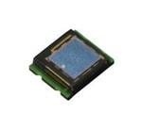
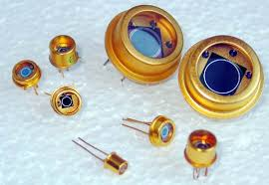
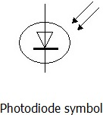
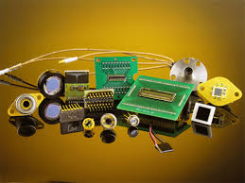
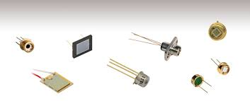
PIN diodes
Excellent quantum efficiency (Typically >80%)
Quantum efficiency (QE) is the probability that a single photon of the correct wavelength causes an electron hole pair to be created.
Widely used.
GaAs, Si: suitable for short wavelength
InGaAs / InGaAsP: suitable for long wavelength

Slide 9
Problem
1 nW of 1550nm light is incident on a pin diode with a 100% quantum efficiency. What is the maximum current that can be produced without amplification?

Slide 10
Problem
1 nW of 1550nm light is incident on a pin diode with a 100% quantum efficiency. What is the maximum current that can be produced without amplification?
1550nm = 193.4 THz and thus each photon has 1.28E-19 Joules
1nW is equivalent to 1E-9/1.28E-19 photons/s
= 7.8E9 photons/s
At 100% QE that’s 7.8E9 electrons /s
1A is 1 Columb/s = 1/1.6E-19 electrons/s = 6.24E18
Thus 7.8E9/6.24E18 = ~1.26E-9 = 1.26nA
Remember: Watt = Joule/s
Remember: electron charge = 1.6E-19

Slide 11
PIN diodes
With just nA of current, how do you get a good signal?
Amplifiers. (See asynchronous lecture)

Slide 12
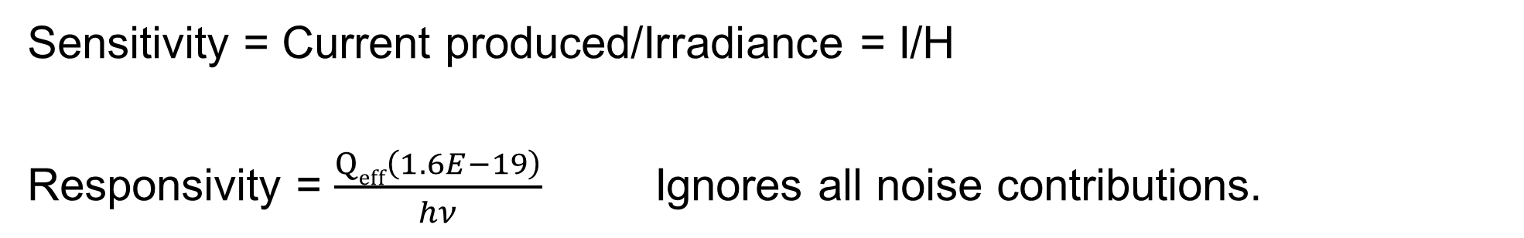
Receivers
Sensitivity = Current produced/Irradiance = I/H
Responsivity = $\frac{Qeff\left(1.6E−19\right)}{hν}$ Ignores all noise contributions.

Slide 13
Receivers
R
p
Reverse biased so that E-field can be applied across the PD active layer
The e-h pair generated is extracted by the applied voltage to form a current.
+
E-field
-
+
i
Modulated light
n
-
Modulated light

Slide 14
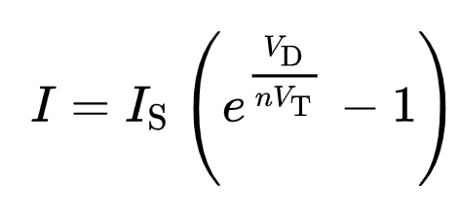
Receivers
Dark current:
Given by Shockley diode equation
I is the diode current,
I_{S} is the reverse bias saturation current (or scale current),
V_{D} is the voltage across the diode,
V_{T} is the thermal voltage k_{B}T/e (Boltzmann constant times temperature divided by electron charge),
n is the ideality factor = 1 for ideal diode. 2 for a very bad diode.
Is a major source of noise!
Note: T is in Kelvin
k_{B} = 1.38064852 × 10⁻²³ m² kg s⁻² K⁻¹

Slide 15
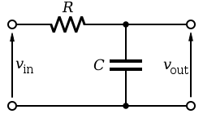
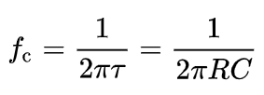
Receiver bandwidth
Do you remember the RC cut-off frequency? time constant = 1/RC frequency
-
+
Bandwidth is limited by two factors
  RC time constant.
  Transit time of electrons and holes.

Slide 16
PIN structure
P-I-N PD contains an intrinsic semiconductor layer (i) between p- and n-layer.
Heterostructure: the p or n layer have wider bandgap – no absorption in these layers.
  No diffusion current
The i-layer thickness can be changed to achieve trade-off between responsivity and bandwidth:
p
i
light
n
-
+
E-field
W

Slide 17
Transit time
v_{d} is the saturation drift speed of carriers (~10⁵ m/s)
W: width of depletion region (several micro-meters)
Reason for operating under reverse bias: to accelerate carriers to V_{d}
t_{tr} ~ 100ps for W=10mm

Slide 18

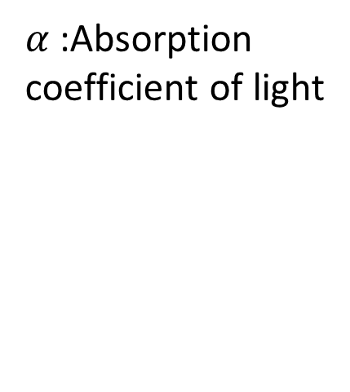
Bandwidth responsivity trade off
$$η=\left[1−\exp\left(−αW\right)\right]$$
$α$ :Absorption coefficient of light
BW: dominated by transit time and RC time constant
  As thickness W increases:
    Efficiency (responsivity): increase
    C: reduce
    Transit time: increase
  BW and Responsivity often is a pair of trade-off parameters for PIN designs of relatively thick i-layer

Slide 19
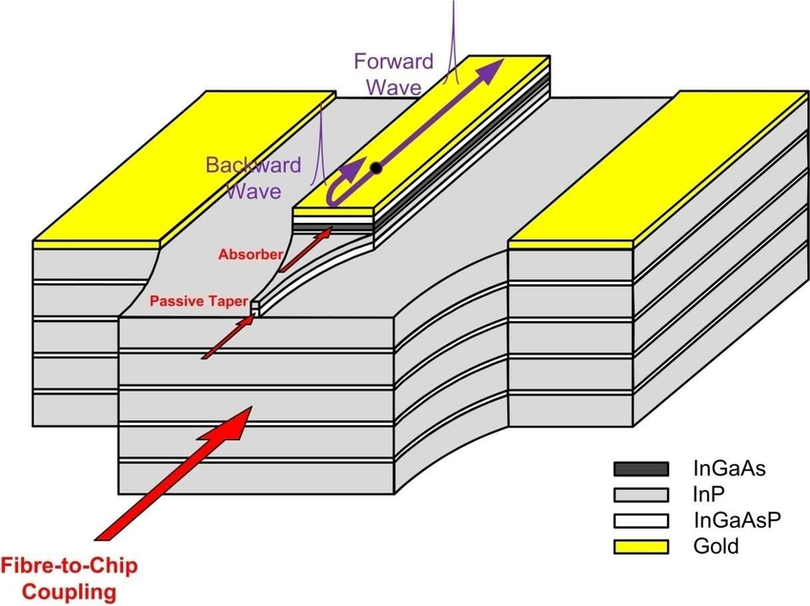
Bandwidth responsivity trade off
Electric pulse
Vertical incident
Horizontal
incident
Light pulse
Smaller area and special design to achieve low capacitance
Travelling wave electrode / waveguide detector: match the light pulse group speed with the electrical pulse group speed

Slide 20
Receiver noise
Dark Current – already covered
Thermal Noise – White noise due to not being at 0K
Shot Noise – The absolute minimum achievable on the best detectors

Slide 21
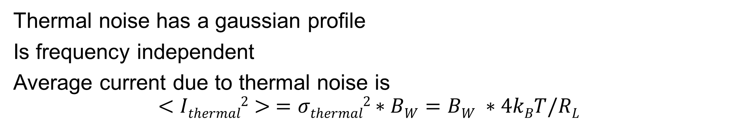
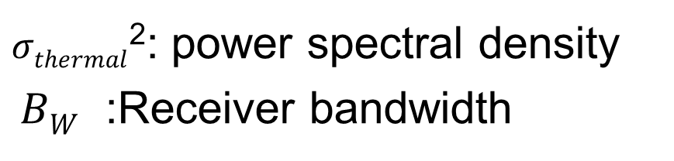
Thermal Noise
Also called Johnson noise
Thermal noise has a gaussian profile
Is frequency independent
Average current due to thermal noise is
$$<Ithermal2> =σthermal2∗BW=BW ∗4kBT/RL$$
R_{L}
$σthermal$²: power spectral density
$BW$ :Receiver bandwidth
p
+
E-field
-
+
You can increase R_{L} to lower the thermal noise but that will change the bandwidth
i
n
-

Slide 22
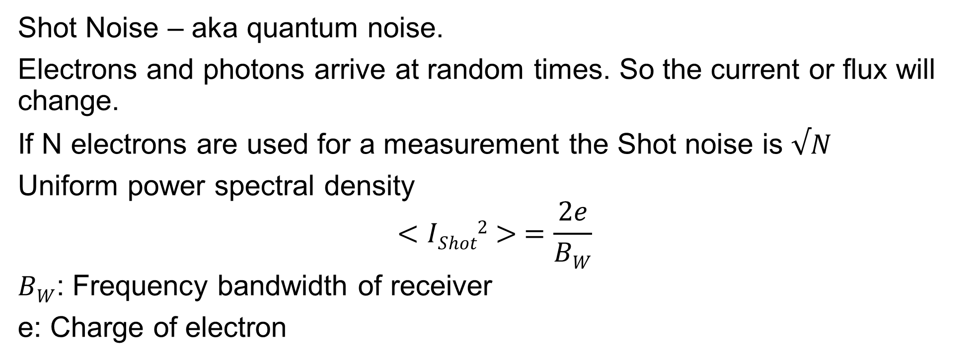
Shot noise
Shot Noise – aka quantum noise.
Electrons and photons arrive at random times. So the current or flux will change.
If N electrons are used for a measurement the Shot noise is $√N$
Uniform power spectral density
$$<IShot2> =\frac{2e}{BW}$$
$BW$: Frequency bandwidth of receiver
e: Charge of electron
Very hard to reach Shot noise limit. More about this when we study homodyne detection (week 15)

Slide 23
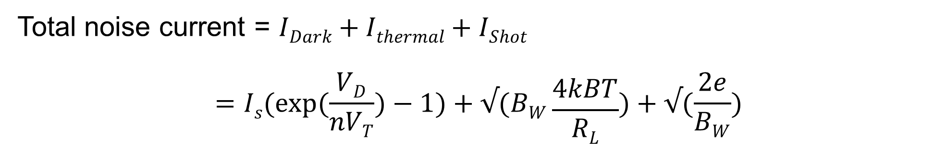
Receiver noise
Dark Current – already covered
Thermal Noise – White noise due to not being at 0K
Shot Noise – The absolute minimum achievable on the best detectors
Total noise current = $IDark+Ithermal+IShot$
$$=Is(exp⁡(\frac{VD}{nVT})−1)+√(BW\frac{4kBT}{RL})+√(\frac{2e}{BW})$$

Slide 24
Receiver noise
Dark Current – already covered
Thermal Noise – White noise due to not being at 0K
Shot Noise – The absolute minimum achievable on the best detectors
Often combined together into RMS noise
Total noise current = $IDark+Ithermal+IShot$
$$=Is(exp⁡(\frac{VD}{nVT})−1)+√(BW\frac{4kBT}{RL})+√(\frac{2e}{BW})$$
RMS: Root Mean Squared. RMS current has units A/Hz^{-1/2}

Slide 25
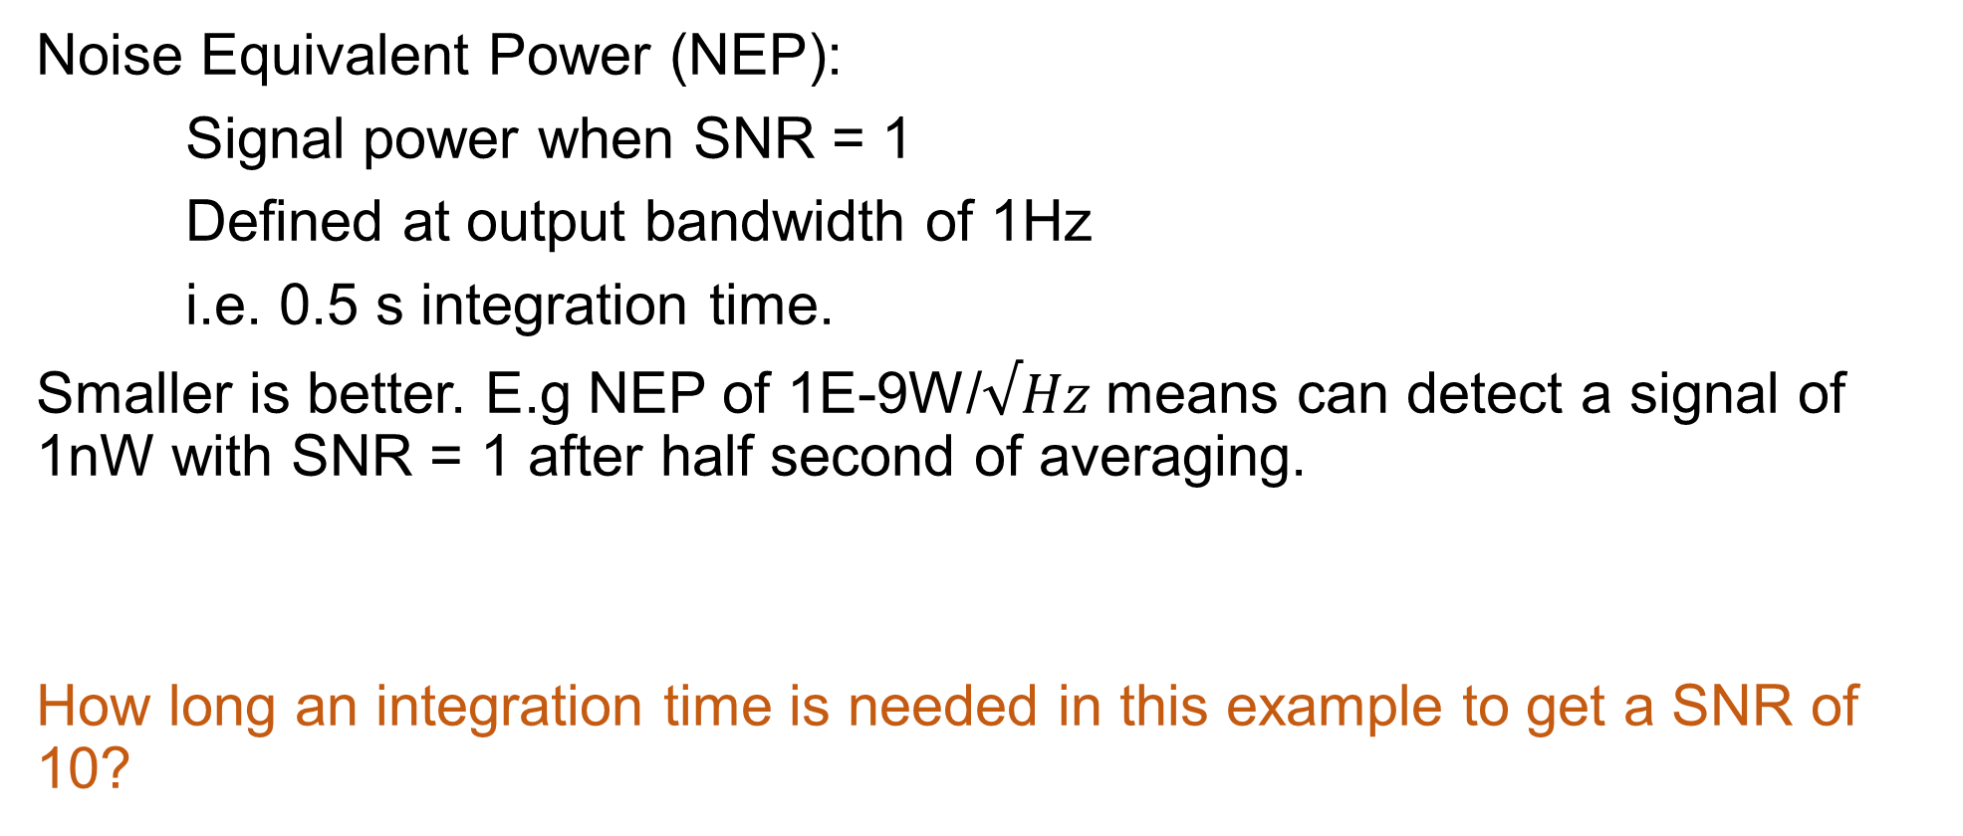
Receiver noise
Noise Equivalent Power (NEP):
Signal power when SNR = 1
Defined at output bandwidth of 1Hz
i.e. 0.5 s integration time.
Smaller is better. E.g NEP of 1E-9W/$√Hz$ means can detect a signal of 1nW with SNR = 1 after half second of averaging.
How long an integration time is needed in this example to get a SNR of 10?

Slide 26
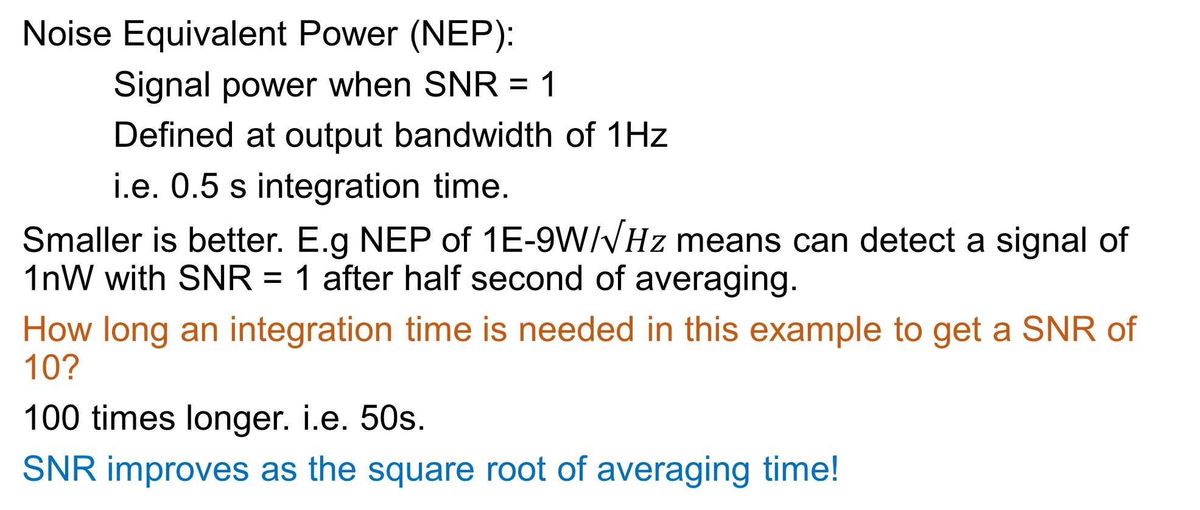
Receiver noise
Noise Equivalent Power (NEP):
Signal power when SNR = 1
Defined at output bandwidth of 1Hz
i.e. 0.5 s integration time.
Smaller is better. E.g NEP of 1E-9W/$√Hz$ means can detect a signal of 1nW with SNR = 1 after half second of averaging.
How long an integration time is needed in this example to get a SNR of 10?
100 times longer. i.e. 50s.
SNR improves as the square root of averaging time!

Slide 27
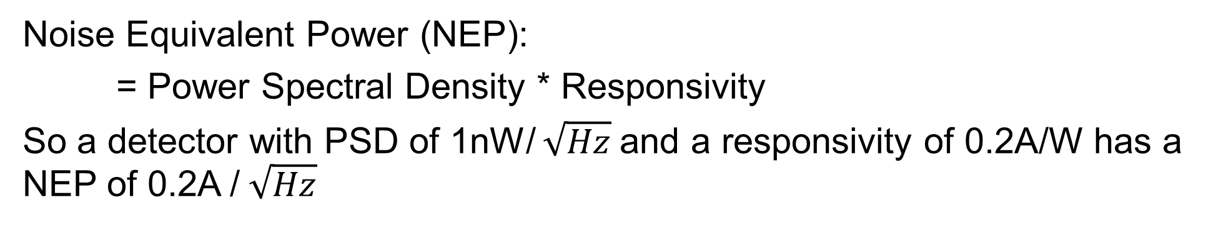
Receiver noise
Noise Equivalent Power (NEP):
= Power Spectral Density * Responsivity
So a detector with PSD of 1nW/ $\sqrt{Hz}$and a responsivity of 0.2A/W has a NEP of 0.2A / $\sqrt{Hz}$

Slide 28
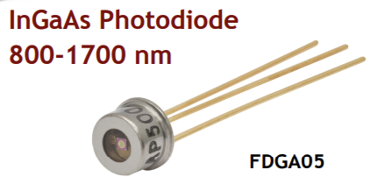
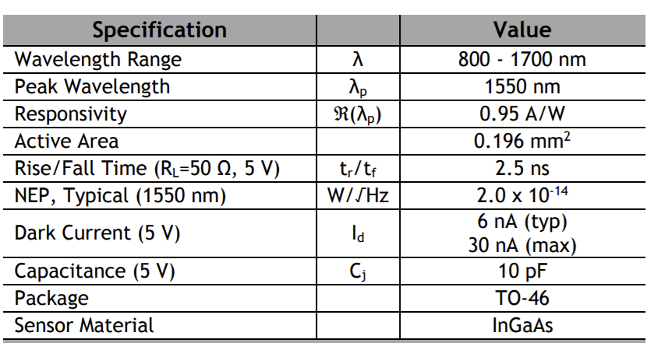
Systems example
Using this receiver
The receiver is 50 Ohm coupled
Use typical dark current value

Slide 29
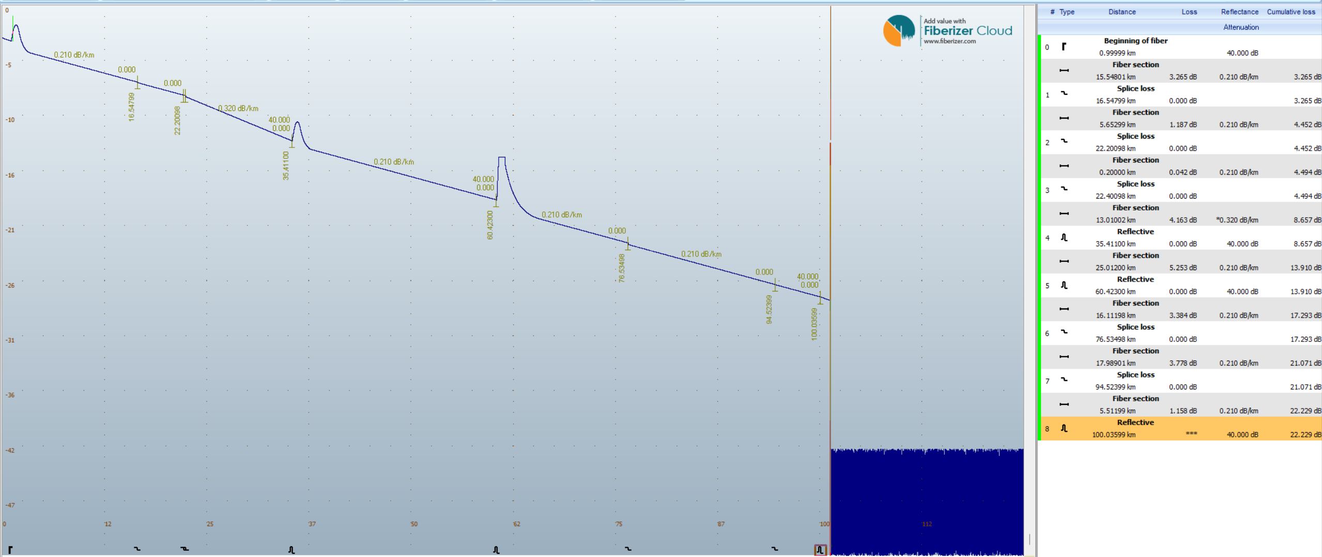
Systems example
Using this fibre
Relevant values given below.
Length 100 km
Total loss 22.3 dB @1550nm

Slide 30
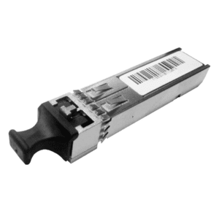
Systems example
And this transmitter
Relevant values given below.
Direct Drive Amplitude modulated signal
DC to 100 GHz
Peak transmit power 10mW
1550nm
No amplitude noise.
Note: This is not a real transmitter. It is a general example for this problem

Slide 31
Systems example
What is the highest speed data link you can have using a m-ASK protocol. What is the highest value of m ? Assume that the SNR for each symbol needs to be >=10
In the exam, I may give you real data sheets of real equipment for similar questions.
You need to be able to extract the relevant information and solve such problems.

Slide 32
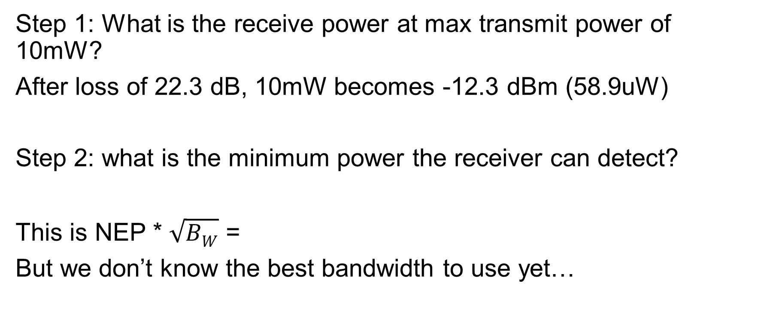
Solution
Step 1: What is the receive power at max transmit power of 10mW?
After loss of 22.3 dB, 10mW becomes -12.3 dBm (58.9uW)
Step 2: what is the minimum power the receiver can detect?
This is NEP * $\sqrt{BW}$ =
But we don’t know the best bandwidth to use yet…

Slide 33
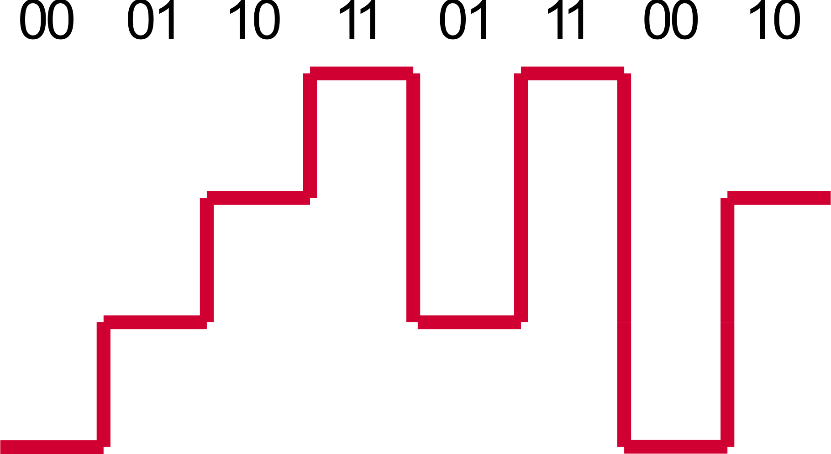
Solution
Step 3: What is the max bandwidth of the receiver?
The RC low pass filter has 10pf and 50 Ohm.
That’s 318.3 MHz cut off frequency.
So we know the max baud rate the receiver can support is 318.3 MHz
Step 4: How many symbols can the receiver distinguish ?
This height must be >= 10 times noise level

Slide 34
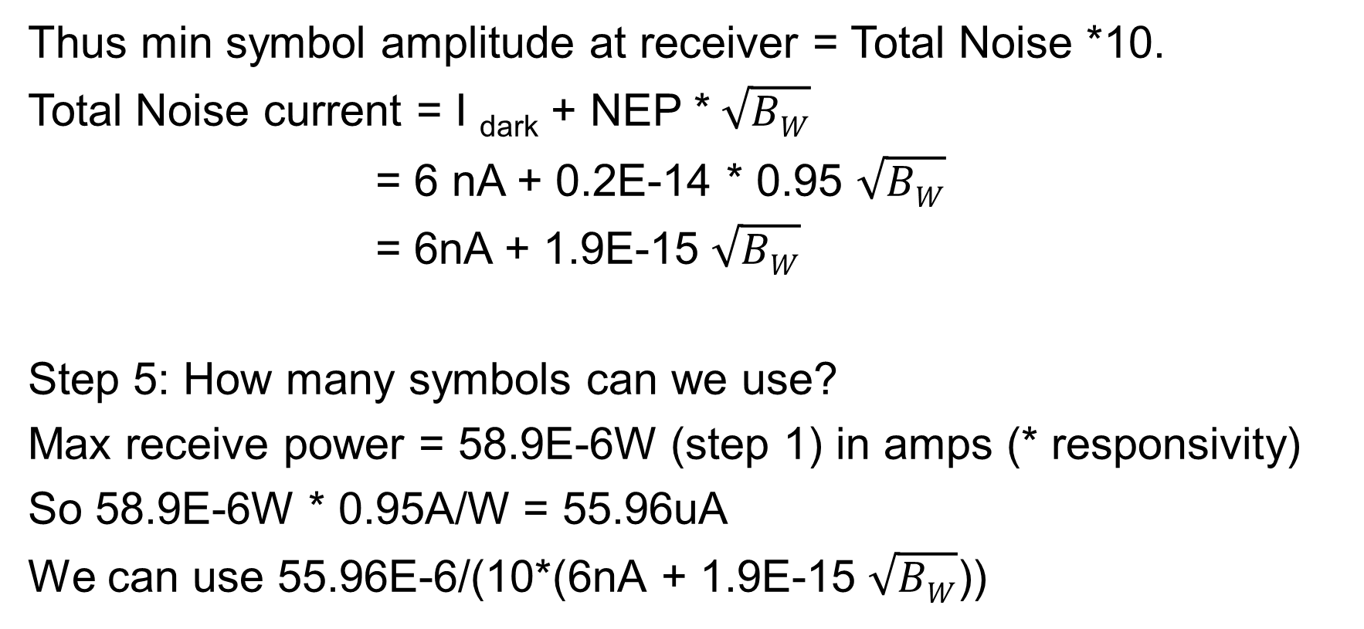
Solution
Thus min symbol amplitude at receiver = Total Noise *10.
Total Noise current = I _{dark} + NEP * $\sqrt{BW}$
= 6 nA + 0.2E-14 * 0.95 $\sqrt{BW}$
= 6nA + 1.9E-15 $\sqrt{BW}$
Step 5: How many symbols can we use?
Max receive power = 58.9E-6W (step 1) in amps (* responsivity)
So 58.9E-6W * 0.95A/W = 55.96uA
We can use 55.96E-6/(10*(6nA + 1.9E-15 $\sqrt{BW}$))

Slide 35

Solution
But log₂ [55.96E-6/(10*(6nA + 1.9E-15 $\sqrt{BW}$))] must be an integer

Slide 36
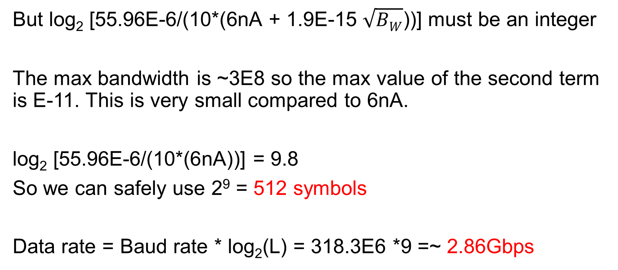
Solution
But log₂ [55.96E-6/(10*(6nA + 1.9E-15 $\sqrt{BW}$))] must be an integer
The max bandwidth is ~3E8 so the max value of the second term is E-11. This is very small compared to 6nA.
log₂ [55.96E-6/(10*(6nA))] = 9.8
So we can safely use 2⁹ = 512 symbols
Data rate = Baud rate * log₂(L) = 318.3E6 *9 =~ 2.86Gbps

Slide 37
Problem
Consider an optical communication terminal on a satellite with a very large 20cm transmit aperture for the telescope. This satellite is sending an optical signal to another satellite with the same sized receiving aperture (20cm). If the second satellite is 1000 km away what is the total optical loss in dB. Wavelength = 1550nm
Note: The correct way to do this calculation is to integrate a gaussian function within the limits of the receiver aperture. Those interested can try this on their computers. However, to simplify the calculations let us assume that the beam that reaches the receiver has a flat top profile. (i.e. the radial cross section of the intensity is constant and does not follow a gaussian distribution)
Hint: If you calculate the beam expansion in just one dimension you will nor get the complete answer. Remember that the beam has a circular cross section. So you need to consider the total area of the beam and the total area of the receive aperture.

Slide 38
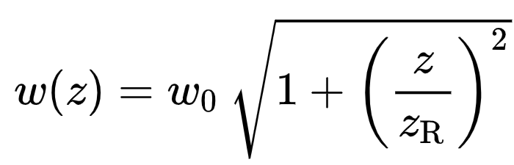
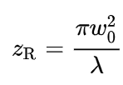

10*log
Problem
Step 1: With a waist of 20cm and a distance of 1000km what is the final beam size?
2.47m
Step 2: What is the area of the beam and the receiver aperture?
Area of circle $=πr^{2}$
Area of beam = 19.2 m²
Area of receiver = 0.125 m²
Transmission = 0.125/19.2 = 6.53E-3 in dB 10*log₁₀(6.53E-3) = -21.8 dB

